Slide 1
Layered Models

Slide 2
The OSI Model
A principled, standardised 7-layer model
7 | Application | - | Functions needed by users
6 | Presentation | - | Converts different representations
5 | Session | - | Manages task dialogs
4 | Transport | - | Provides End-to-End delivery
3 | Network | - | Sends packets over multiple links
2 | Data Link | - | Sends frames of information
1 | Physical | - | Sends bits as signals

Slide 3
Hop-by-Hop / End-to-End
End-to-End
Layers 4, 5, 6 and 7 are concerned with end-to-end interaction - between a process in the source host and a process in the destination host.

Slide 4
Hop-by-Hop / End-to-End
Hop-by-Hop
Layers 1, 2, 3 just send data a distance of one hop - to the next device or eventually to the destination host.
Layer 1 conveys 0s and 1s, but with some errors or losses.
Layer 2
creates frames that can be re-transmitted if necessary to recover from errors/losses.
Medium access control: L2 also resolves conflict where more than one physical device try to transmit on the physical channel
Each frame contains a payload that is a packet from Layer 3.
Layer 3: How to get from A to B
L3 is aware of the topology of the network and how best to route packets through the network - i.e. to which neighbour a packet should be passed.
It provides delivery from host machine to host machine, normally via multiple hops.

Slide 5
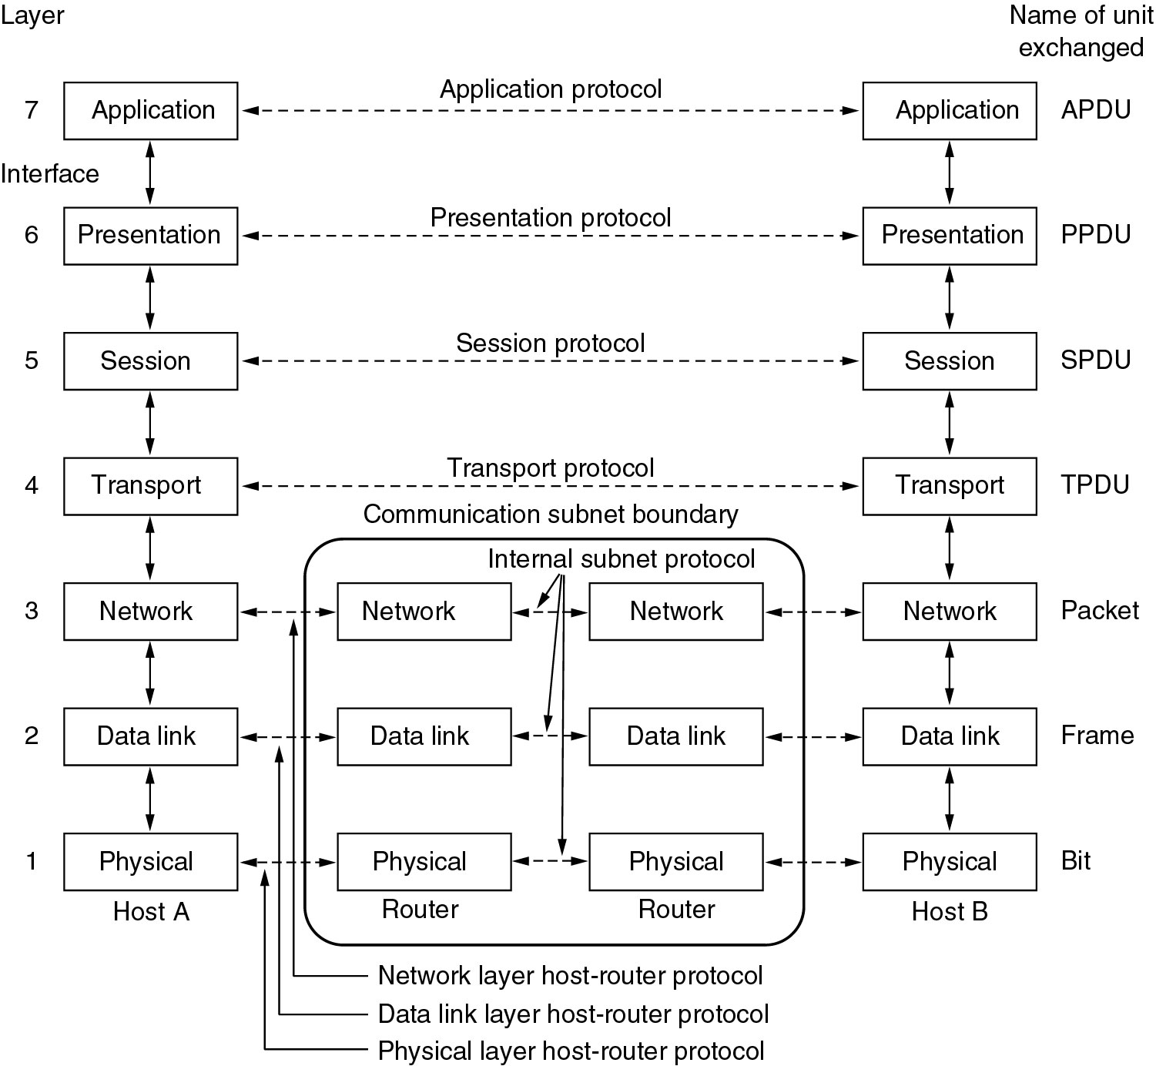
The OSI model

Slide 6
TCP/IP
 | OSI |  | TCP/IP
7 | Application |  | Application | 5
6 | Presentation |  |  |  | Omitted
5 | Session
4 | Transport |  | Transport | 4
3 | Network |  | Internet | 3
2 | Data Link |  | Link | 2
1 | Physical |  | Physical

Slide 7
TCP/IP Reference Model
Derived from experimentation.
Omits some OSI layers and uses IP at L3
Today’s internet!

Slide 8
Hybrid Model
Model used in your textbook: Based on the TCP/IP layer
5 | Application
4 | Transport
3 | Network
2 | Data Link | (or just Link)
1 | Physical | (or PHY)

Slide 9
Critique
OSI:
+ Very influential, clear concepts
- Bogged down by politics and complexity
TCP/IP:
+ Very successful, simple protocols, that actually work
- Weak model, derived after the fact: Protocols came before the model

